Slide 1
Personal Banking - Accounts
Fresher Learning Program

Slide 2
Customer Information File (CIF)
A customer information file (CIF) is an electronic file that stores all pertinent information about a customer's personal and account information. The customer information file (CIF), which contains a CIF number, allows the business to view its customer accounts by relationship and not strictly by account type. A CIF at a bank might include a client's credit relationships, accounts owned, and ownership information.

Slide 3
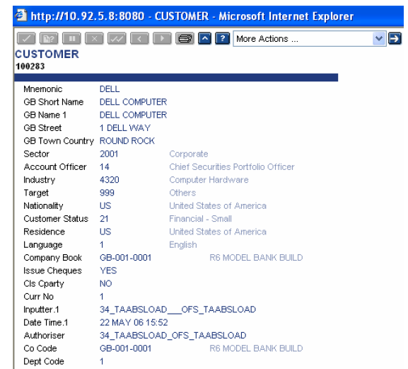
Customer Information File (CIF)

Slide 4
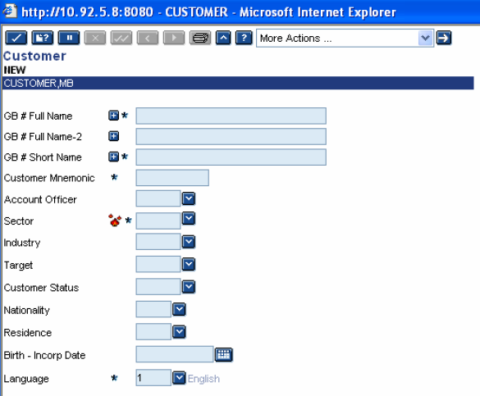
Customer Information File (CIF)

Slide 5
Customer Information File (CIF)
Following details need to be updated while creating Customer Account
GB# Full Name - Name of the Customer used for correspondence.
GB# Full Name- 2 - Continuation of Full Name
GB # Short Name - Name to be used for on-line enrichments in any field where a Customer ID or Mnemonic has been input.
Customer Mnemonic - Specifies an alternative easy means of referencing the Customer.
Account Officer - Identifies the Relationship Officer responsible for the Customer. Desired officer can be picked from the drop down list.
Sector - T24 allows classification of customers using this field say, Individuals, Corporate, Banks etc and assigning a numeric code to them.
Industry – Yet another classification field to identify the industry of the customer and normally used for Central Bank reporting purposes.

Slide 6
Customer Information File (CIF)
Customer Status - Identifies the Status of the Customer. Appropriate status can be selected from the drop down list.
Target - Specifies how the Customer is considered by the bank and how he fits in with the Account Officer's overall marketing strategy.
Nationality - Identifies the Nationality of the Customer.
Residence - Identifies the Country of Residence of the Customer.
Birth Date - Specifies the Customer's date of birth
Language – The communication language of the customer. It is defaulted to English.

Slide 7
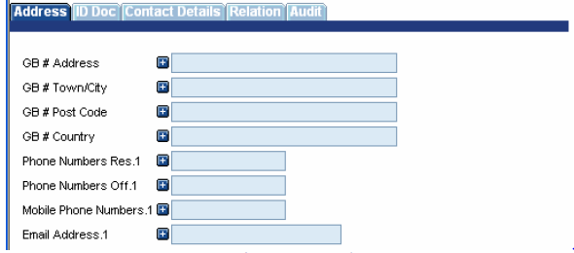
Customer Information File (CIF)
GB # Address - Identifies the first line of the customer's base address.
GB # Town/City - Identifies the town and country of the customer's base address.
GB # Post Code - Identifies the postal code for customer.
GB # Country - Identifies the country for customer.
Phone Numbers Res.1
Phone Numbers Off.1
Mobile Phone number .1
Email Address.1 -

Slide 8
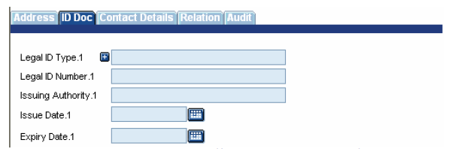
Customer Information File (CIF)
Legal ID type - Records the type of Identification document perused by the bank like SSN, Passport, and Licence etc.
Legal ID number – Records the number on the ID document.
Issuing authority, Issue Date and Expiry Date - Details of the authority issuing the ID

Slide 9
Savings Account
A savings account is an interest-bearing deposit account held at a bank or other financial institution. Though these accounts typically pay a modest interest rate, their safety and reliability make them a great option for parking cash you want available for short-term needs.
Savings accounts pay interest and keep your funds easy to access, they’re a good option for parking cash you’ll want in the short-term or to cover an emergency. In exchange for the ease and liquidity that savings accounts offer, you’ll earn a lower rate than more restrictive savings instruments and investments might pay.
All resident Indian customers more than 18 years of age are eligible to open Savings Account. Savings Account can be opened through Branch & Online Banking.

Slide 10
Features of Savings Account
A Savings bank account is a safe place to store surplus funds
The balance in a savings account earns interest.
Savings account interest rates on savings account can range from 3.5% to 7% p.a.
Easy access to internet banking and mobile banking
Most banks also provide savings account holders with various insurance covers including personal accidents and death.
ATMs can be used all across India with your debit card.
Cheque Book facility

Slide 11
Types of Savings Bank Account
1. Regular Savings Account
These are opened on basic terms and conditions. The regular savings accounts do not see regular deposits of consistent amounts, and are the equivalent of a safe house where money is kept for safe keeping.
2. Salary-based Savings Account
These accounts are opened by banks on the request of companies which require a platform for payment disbursal. Banks offer preferential rates and terms for these kinds of accounts. When the date of payment disbursal arrives, the bank withdraws money from the company account and disburses the money. One must note that almost most salary accounts will not have a minimum balance requirement. If salary is not credited for 3 consecutive months, the accounts will be converted into a regular savings account.

Slide 12
Types of Savings Bank Account
3. Senior Citizens Savings Accounts
The accounts function in the very same way like regular savings accounts, but it offers much higher rates of interest and banking privileges for senior citizens. These accounts will be linked to other senior citizen savings schemes for remitting the funds from their retirement accounts or pension funds, and consolidate all the funds under one single bank account.
4. Minors’ Savings Accounts
These accounts do not have a minimum balance requirement. A minor’s saving account has been curated for educating children about banking facilities and savings accounts. This kind of account can be opened and operated under the supervision of the legal guardian. Once the child reaches 18 years old, the account will be converted into a regular savings account.

Slide 13
Types of Savings Bank Account
5. Zero Balance Savings Account
This account merges the features of a savings account and a current account. While there are limits on withdrawal amounts, you will not charge penalties if the balance falls below the prescribed minimum.
6. Women’s Savings Account
These kinds of accounts come with special features to benefit the account holder. These benefits include discounts on certain purchases, low interest rates on loans, and a waiver on demat account charges.

Slide 14
Current Account
A current account, also known as financial account is a type of deposit account maintained by individuals who carry out significantly higher number of transactions with banks on a regular basis.
Current accounts also allows to make payments to creditors through the cheque facility offered by the bank. Generally, current accounts requires a higher minimum balance when compared to savings account. However, the greatest advantage of current bank account is that, account holders can easily avail overdraft facility up to an agreed limit.
Current accounts are also called demand deposit accounts. No interest is paid on these accounts, sometimes even a fee is charged for banking services.

Slide 15
Features of Current Account
A current account allows transactions beyond the scope of a savings account
Compared to savings account, a current account requires a higher minimum balance
It is designed to facilitate frequent transactions – transfer funds, receive cheques, cash, etc.
A current account can be operated by individuals, proprietary concerns, public and private companies, associations, trusts, etc.
No restriction on the number of transactions in a day
Non-maintenance of the minimum balance can attract penalty charges
There cannot be multiple current accounts for a single customer

Slide 16
Nostro Account
A Nostro account refers to an account that a bank holds in a foreign currency in another bank. Nostros, a term derived from the Latin word for "ours," are frequently used to facilitate foreign exchange and trade transactions.
A nostro is our account of our money, held by the other bank
It is the account which is held by a foreign bank with a domestic bank in domestic currency. For example, if Citibank maintains an account with SBI in India in INR, it will be a vostro account for SBI. Notice that an account which is Nostro for one bank is Vostro for another.

Slide 17
Vostro Account
A Vostro account is an account a correspondent bank holds on behalf of another bank. These accounts are an essential aspect of correspondent banking in which the bank holding the funds acts as custodian for or manages the account of a foreign counterpart.
A vostro is our account of other bank money, held by us
It is the account which is held by a foreign bank with a domestic bank in domestic currency. For example, if Citibank maintains an account with SBI in India in INR, it will be a vostro account for SBI. Notice that an account which is Nostro for one bank is Vostro for another

Slide 18
Account Status
1. Inactive Account
An account with no transactions for a period of 12 months will be classified as "Inactive“
2. Dormant Account
A "Dormant" account means all the account(s) linked to your CIF (Customer Identification File) have had no financial or non-financial transactions and you have had no contact with the bank for a period of 3 years.
For example: If you have a single account and there have been no transactions/contact for a period of 3 years, then that account will become "Dormant". If you hold multiple accounts under your CIF (Customer Identification File) and each one of them have had no transactions/contact for a period of 3 years, then all the accounts will become "Dormant".

Slide 19
Account Status
3. Deceased Account
A deceased account is a bank account, such as a savings or checking account, owned by a deceased person. When a bank receives notice that a customer has died, it will freeze the account(s) while waiting for direction from the authorized court regarding payment to heirs and creditors.
An account with no transactions for a period of 12 months will be classified as "Inactive“
4. Account Blocked/ Frozen
Account freezes are normally the result of a court order and, in some cases, they may be done by the bank itself. This usually occurs when the account holder has unpaid debts to creditors or the government, or when there is suspicious activity detected through the account.

Slide 20
Know Your Customer (KYC)
KYC stands for Know Your Customer. It is a mandatory procedure in India that helps banks, insurance companies and other financial institutions verify prospective customers' addresses and identities before conducting transactions. It includes verifying the customer's identity, address, occupation, residential status, financial status and other personal details.
The KYC process helps financial entities verify that investments/ transactions are being made in a real person's name. This helps cut down unlawful practices like money laundering, fraud or financing illegal activities. KYC compliance is required to open bank accounts, Demat and trading accounts, start fixed deposits or invest in mutual funds. It is even needed if you want to apply for a home or a personal loan.

Slide 21
Aadhaar Paperless Offline e-KYC
UIDAI (Unique Identification Authority of India) provides a mechanism to verify identity of an Aadhaar number holder through an online electronic KYC service. The e-KYC service provides an authenticated instant verification of identity and significantly lowers the cost of paper based verification and KYC.
It is a secure sharable document which can be used by any Aadhaar number holder for offline verification of Identification. A resident desirous of using this facility shall generate his/her digitally signed Aadhaar details by accessing UIDAI resident portal. The details will contain Name, Address, Photo, Gender, DOB, hash of registered Mobile Number, hash of registered Email Address and reference id which contains last 4 digits of Aadhaar Number followed by time stamp in a digitally signed XML. It will provide Offline Aadhaar Verification facility to service providers/Offline Verification Seeking Entity (OVSE) without the need to collect or store Aadhaar number.

Slide 22
Data covered in Aadhar e-KYC
Fields that are always available
Resident Name
Download Reference Number
Optional fields:
Address
Photo
Gender
DoB/YoB
Mobile Number (in hashed form)
Email (in hashed form)

Slide 23
ACCOUNT OPENING PROCESS
Acquisition of the customer by sales/front office staff
Filling in the Customer Master Form
Verification of Forms and KYC documents
Obtaining copies of KYC documents
Filling in the Account Opening Form
Processing at branches permitted to Authorize opening of the Account
Authorisation of the Forms by the branch officials
Crediting Cash/Cheque for initial deposit in the account
Indenting for Debit Card/Internet Banking etc., to CPU
Receipt of cheque book/card etc., by the customer from the branch
Processing at branches not permitted to Authorize opening of the Account
Provisional Authorisation of the Forms by the branch officials
Crediting of Cash/ Cheque for initial deposit in Branch’s Office Account
Creation of Customer Master & Account in the CBS by the branch officials
Despatch of Forms & KYC documents to CPU
Despatch of Welcome Letter, Cheque Book, Debit Card, PINs to the Customer
Generation of Cheque Book/ Debit Card/ Internet/Phone Bkg PINs/ Welcome Letter
Verification of documents by DVU at CPU

